Slide 1



HACKFEST
VISTALEX
A clear vision for text accessibility
Techno International Newtown
Theme Name: Sustainable Business
Team TINT_Hacker_Knights:
Suraj Kumar Biswas
Sayanika Raha
Sayantan Deb
Sayani Pal
Sayandeep Saha

Slide 2

01
Problem Statement
Every day, millions of people — students, professionals, and lifelong learners — silently struggle to read. Not because they lack intelligence or curiosity, but because the system wasn’t built for their brains.
People with dyslexia face mirrored letters and jumbled spacing. Those with ADHD get distracted by visual clutter or lose focus halfway through a paragraph. And individuals with visual impairments often find standard content unreadable — no contrast, no clarity, no consideration.

Slide 3
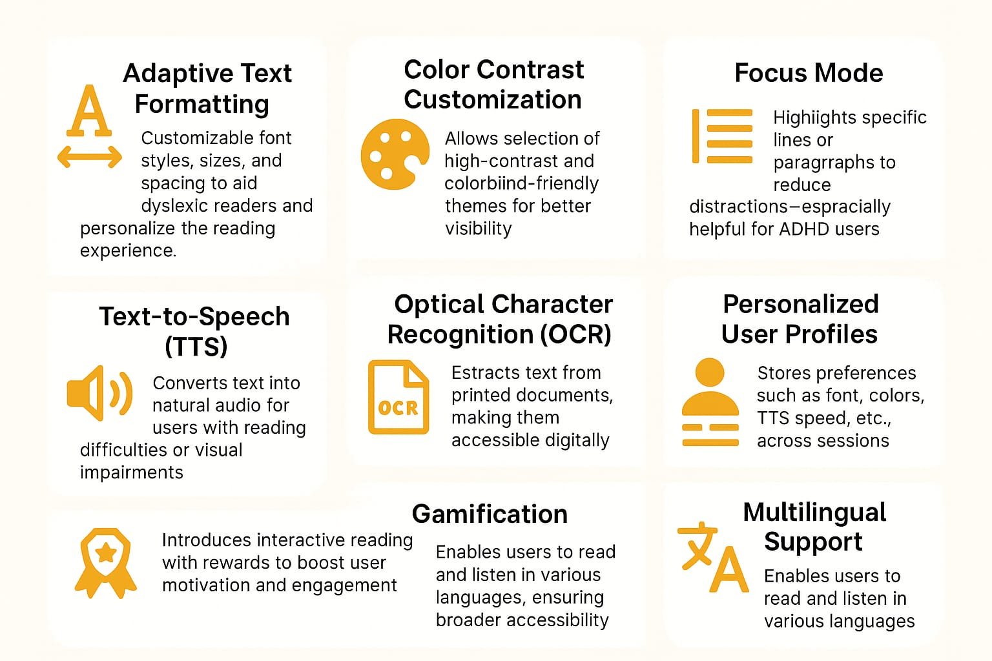
02
Solution
Key Features
Vista Lex is a smart, customizable reading tool designed for individuals with ADHD, dyslexia, and visual impairments, making digital and printed text more accessible and engaging.
Provides adaptive user interfaces based on cognitive and visual needs
Enhances focus, comprehension, and engagement through AI-powered tools
Converts physical and digital content into readable, audio, or personalized formats
Encourages independent learning and information access
Designed for diverse users: students, educators, professionals, elderly readers

Slide 4


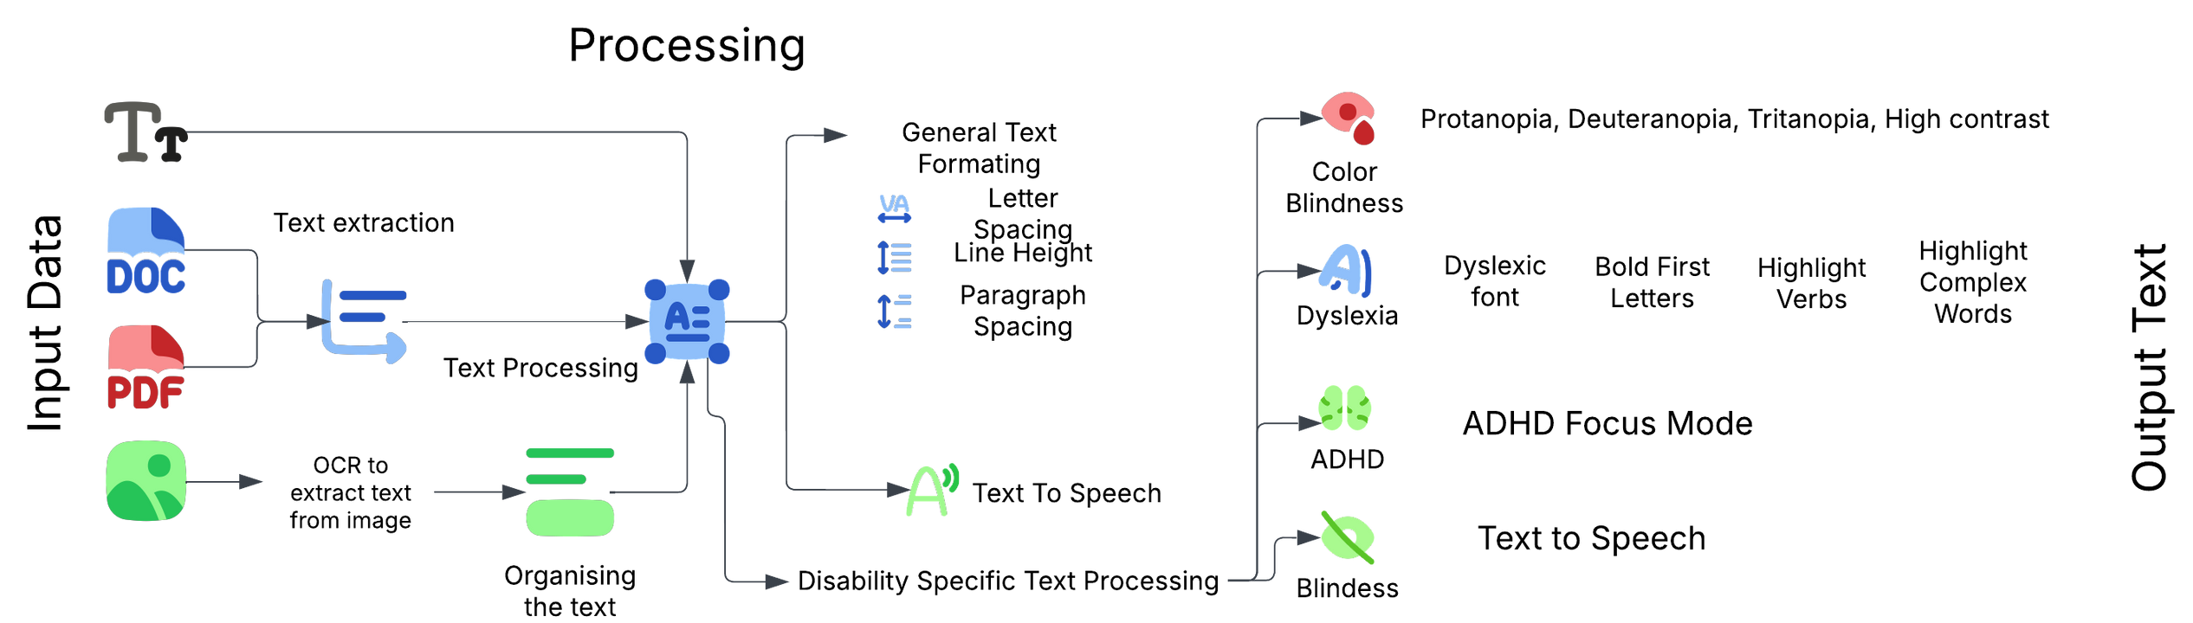
03
Architecture Diagram

Slide 5
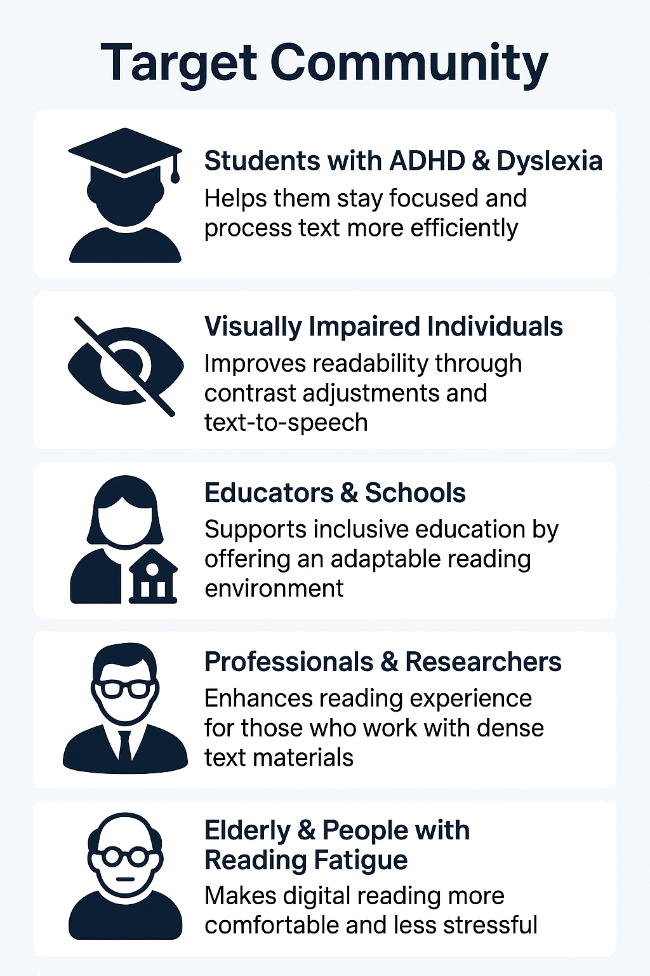


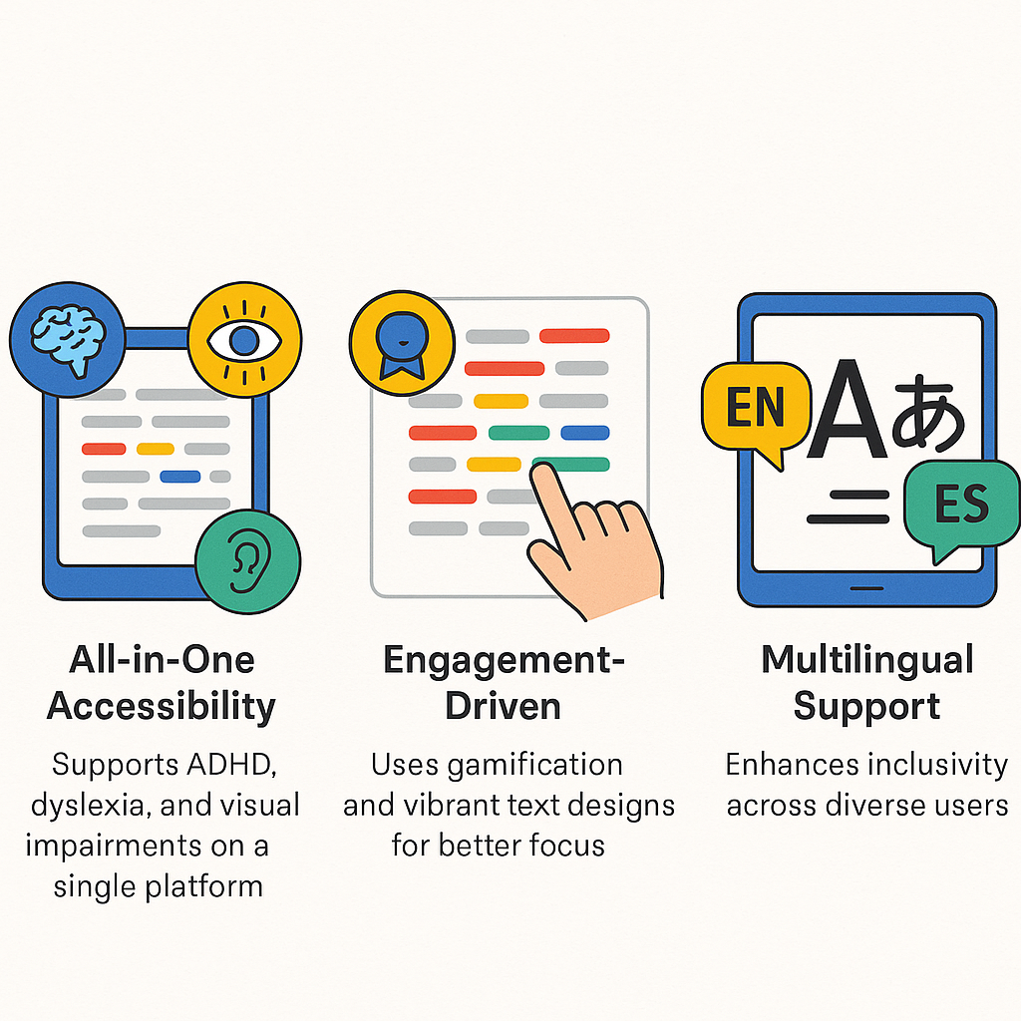
04
Market Survey
Over 200 million Indians face reading challenges due to dyslexia, ADHD, and visual impairments. With 10M+ students struggling with ADHD and 62M visually impaired individuals, assistive reading technology is crucial. Color blindness also impacts text readability.
Unique Selling Points:
All-in-One Accessibility: Supports ADHD, dyslexia, and visual impairments on a single platform.
Engagement-Driven: Uses gamification and vibrant text designs for better focus.
Multilingual Support: Enhances inclusivity across diverse users.

Slide 6
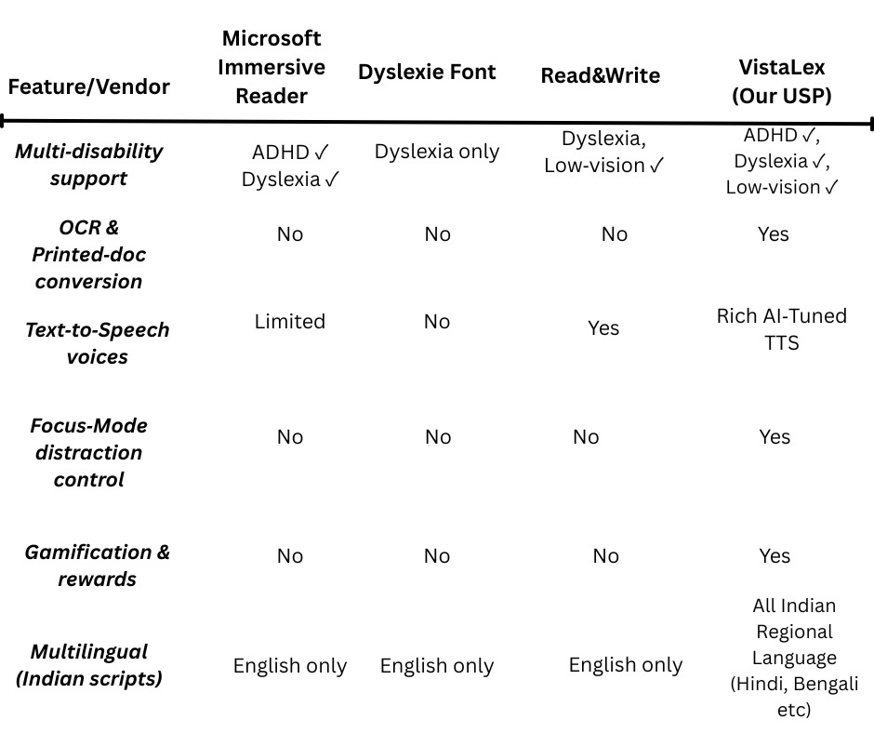
Competitive Landscape
05

Slide 7



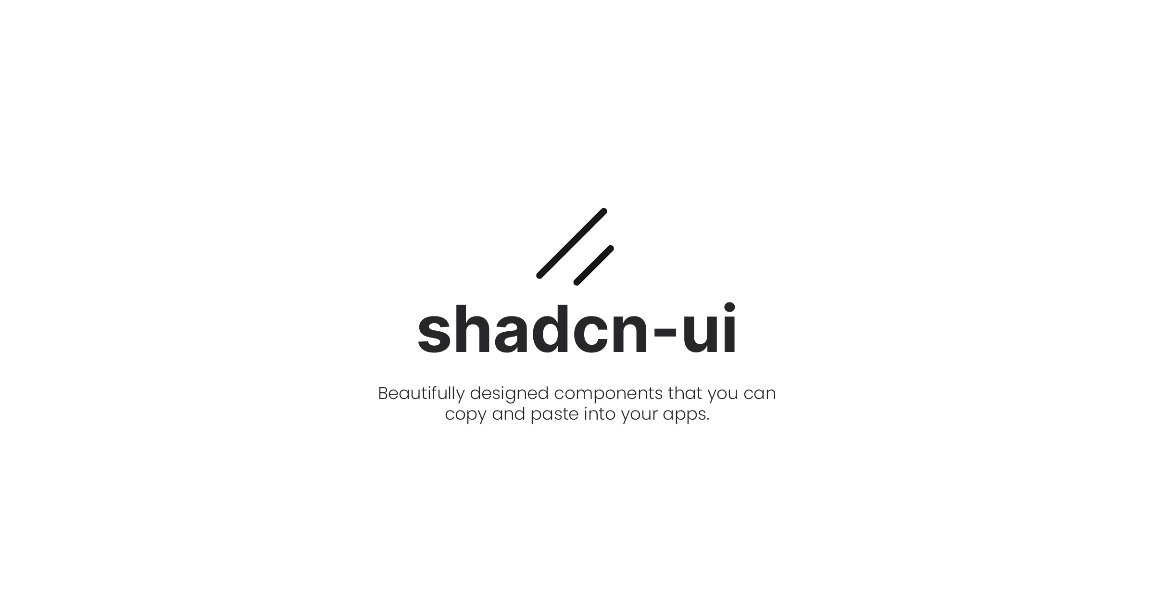
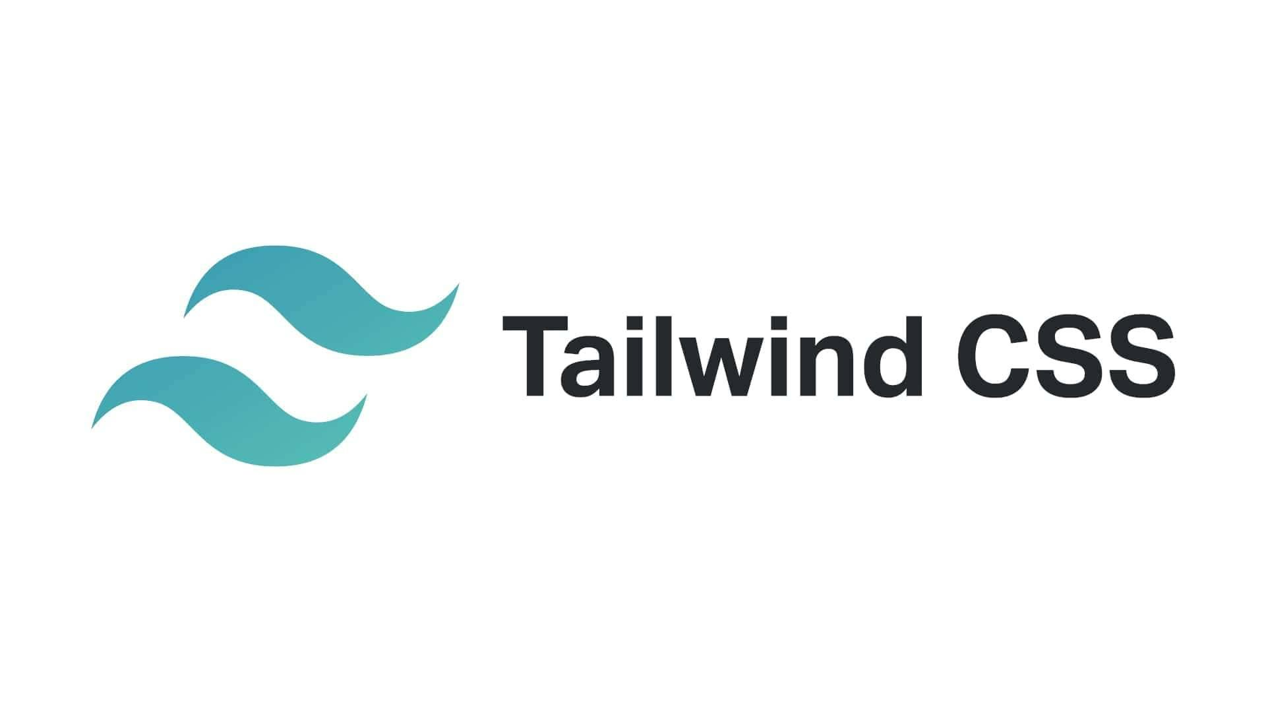



Tech Stack
06
Component list:
Vite
Supabase
Software used:

Slide 8
Revenue Model
07
Year 1 Revenue Projection
Profitability
Metric Amount (₹)
Total Revenue 5,39,970
Total Expenses 1,59,396
Net Profit/(Loss) (3,80,574)
STREAM | ASSUMPTIONS | REVENUE(₹)
B2B SaaS | 5 schools × 100 seats + 3 corporates × 50 seats = 650 users × ₹750 | 4,87,500
B2C Freemium | 200 free uses → 5 % convert = 10 users × ₹99 | 990
Integration Fees | 2 small (₹12K) + 1 mid (₹18K) | 42,000
Language Packs | 120 purchases × ₹79 | 9,480
Total Revenue |  | 5,39,970
Year 1 Outcome: A net profit of ₹3.8 L, typical for an early‑stage startup investing in product and user acquisition.
Fixed Costs
Variable Costs
ITEM | AMOUNT(₹)
Tech infrastructure (domain, cloud, APIs) | 50,000
Salaries (≈1 FTE) | 96,000
Marketing & launch events | 5,000
Legal & compliance | 3,000
Total Fixed | 1,54,000
ITEM | AMOUNT(₹)
Payment gateway fees (2% of rev) | 396
TTS & OCR API usage | 5,000
Total Variable | 5,396
Break‑Even Analysis
Fixed Costs = ₹154000
Assumed Gross Margin = 71.5 %
Break‑Even Revenue = ₹ 2 lakhs
Total Expenses = 1,54,000 + 5,396= ₹1,59,396

Slide 9

Future Scopes
08
01
02
03
Support for More File Formats
Integration with AI Chatbots
Version Control & Text Comparison
Adding support for additional file formats such as scanned Excel files, TIFF images, and email documents can broaden the application's applicability.
Enable users to interact with extracted content using an AI assistant—ask questions about the document or summarize the content automatically.
Maintain a version history of extracted text for the same document and enable visual diff comparison to track changes over time.

Slide 10
Thank You

